Slide 1
Evaluación y Logging en Aplicaciones de IA
Mejores Prácticas y Herramientas

Slide 3
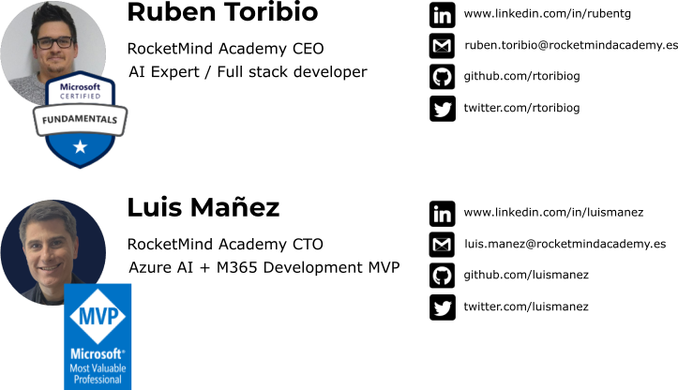
About us

Slide 4
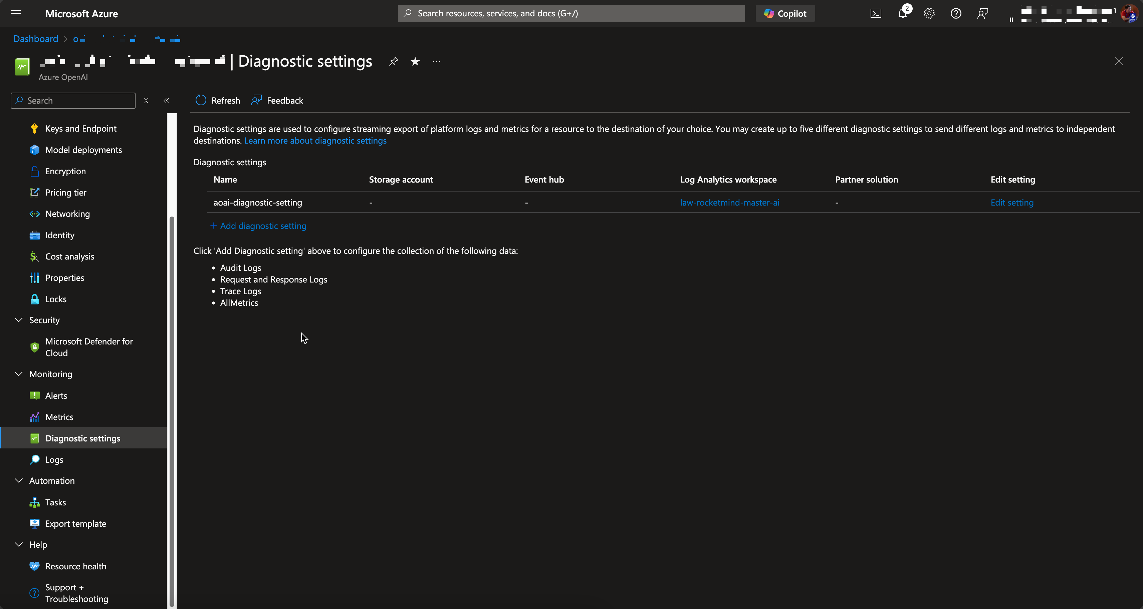
Monitoring Azure OpenAI – OOB Options

Slide 5
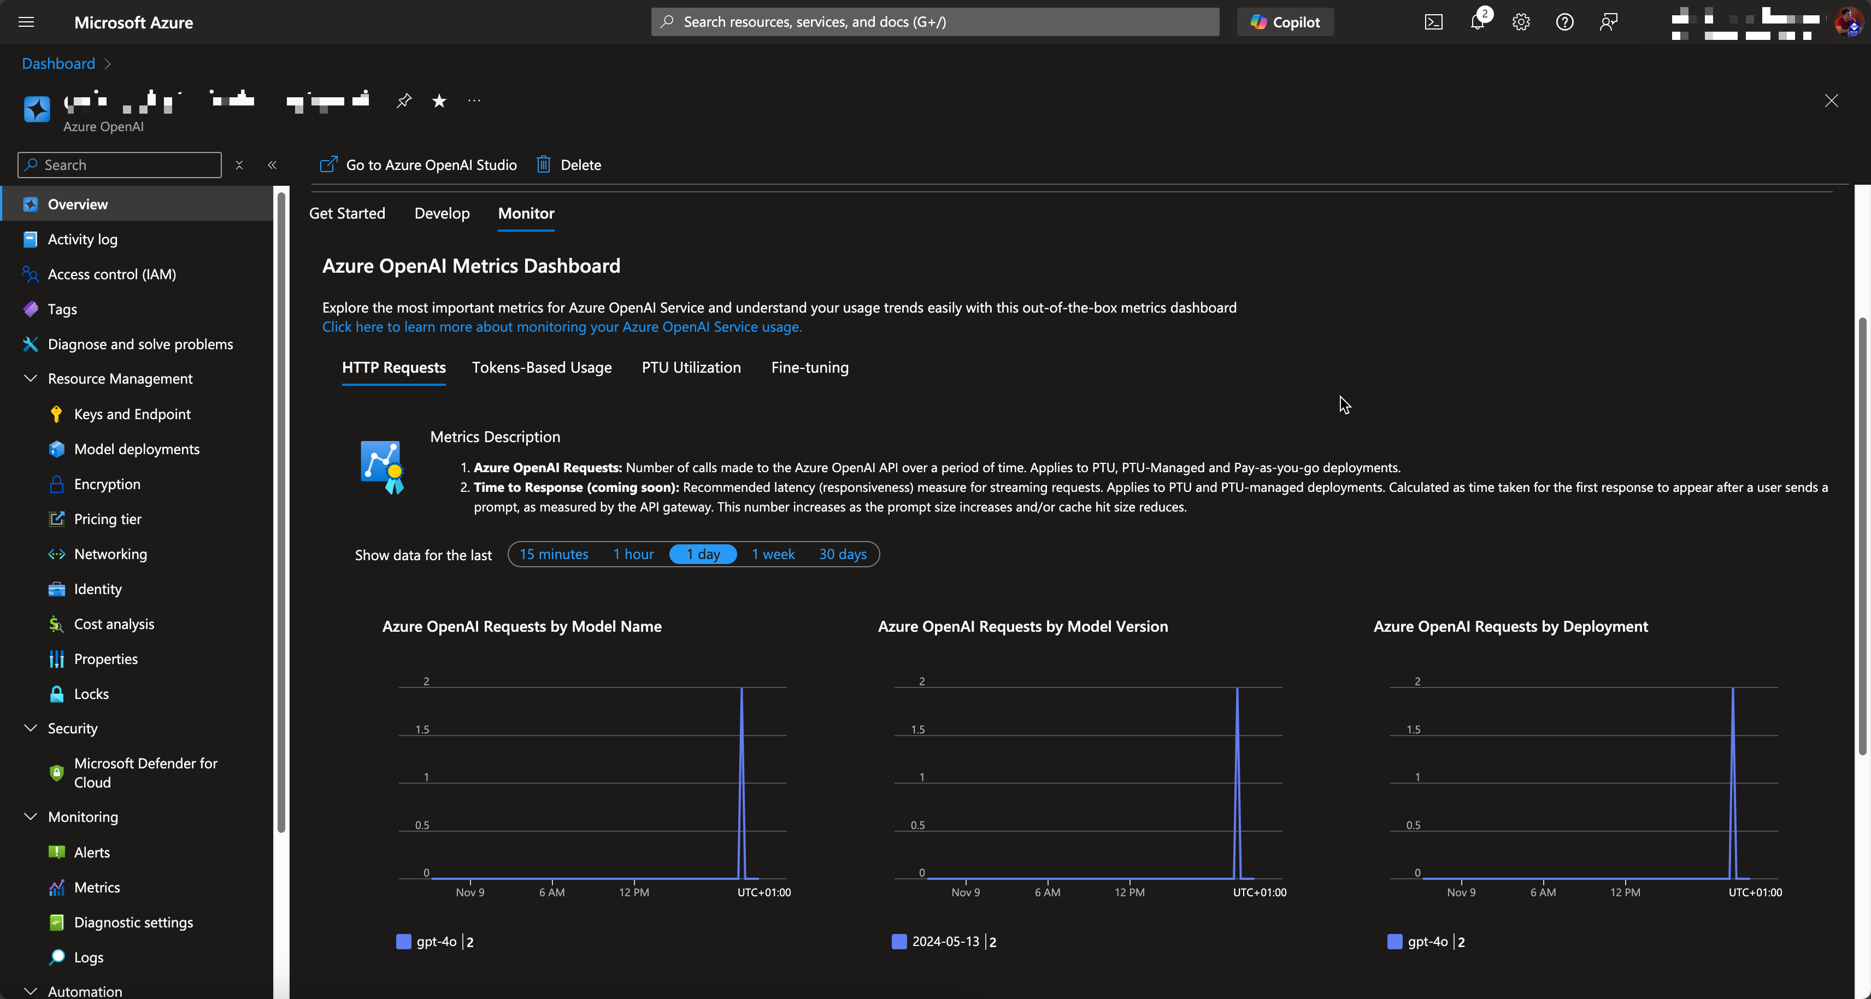
Monitoring Azure OpenAI – OOB Options

Slide 6
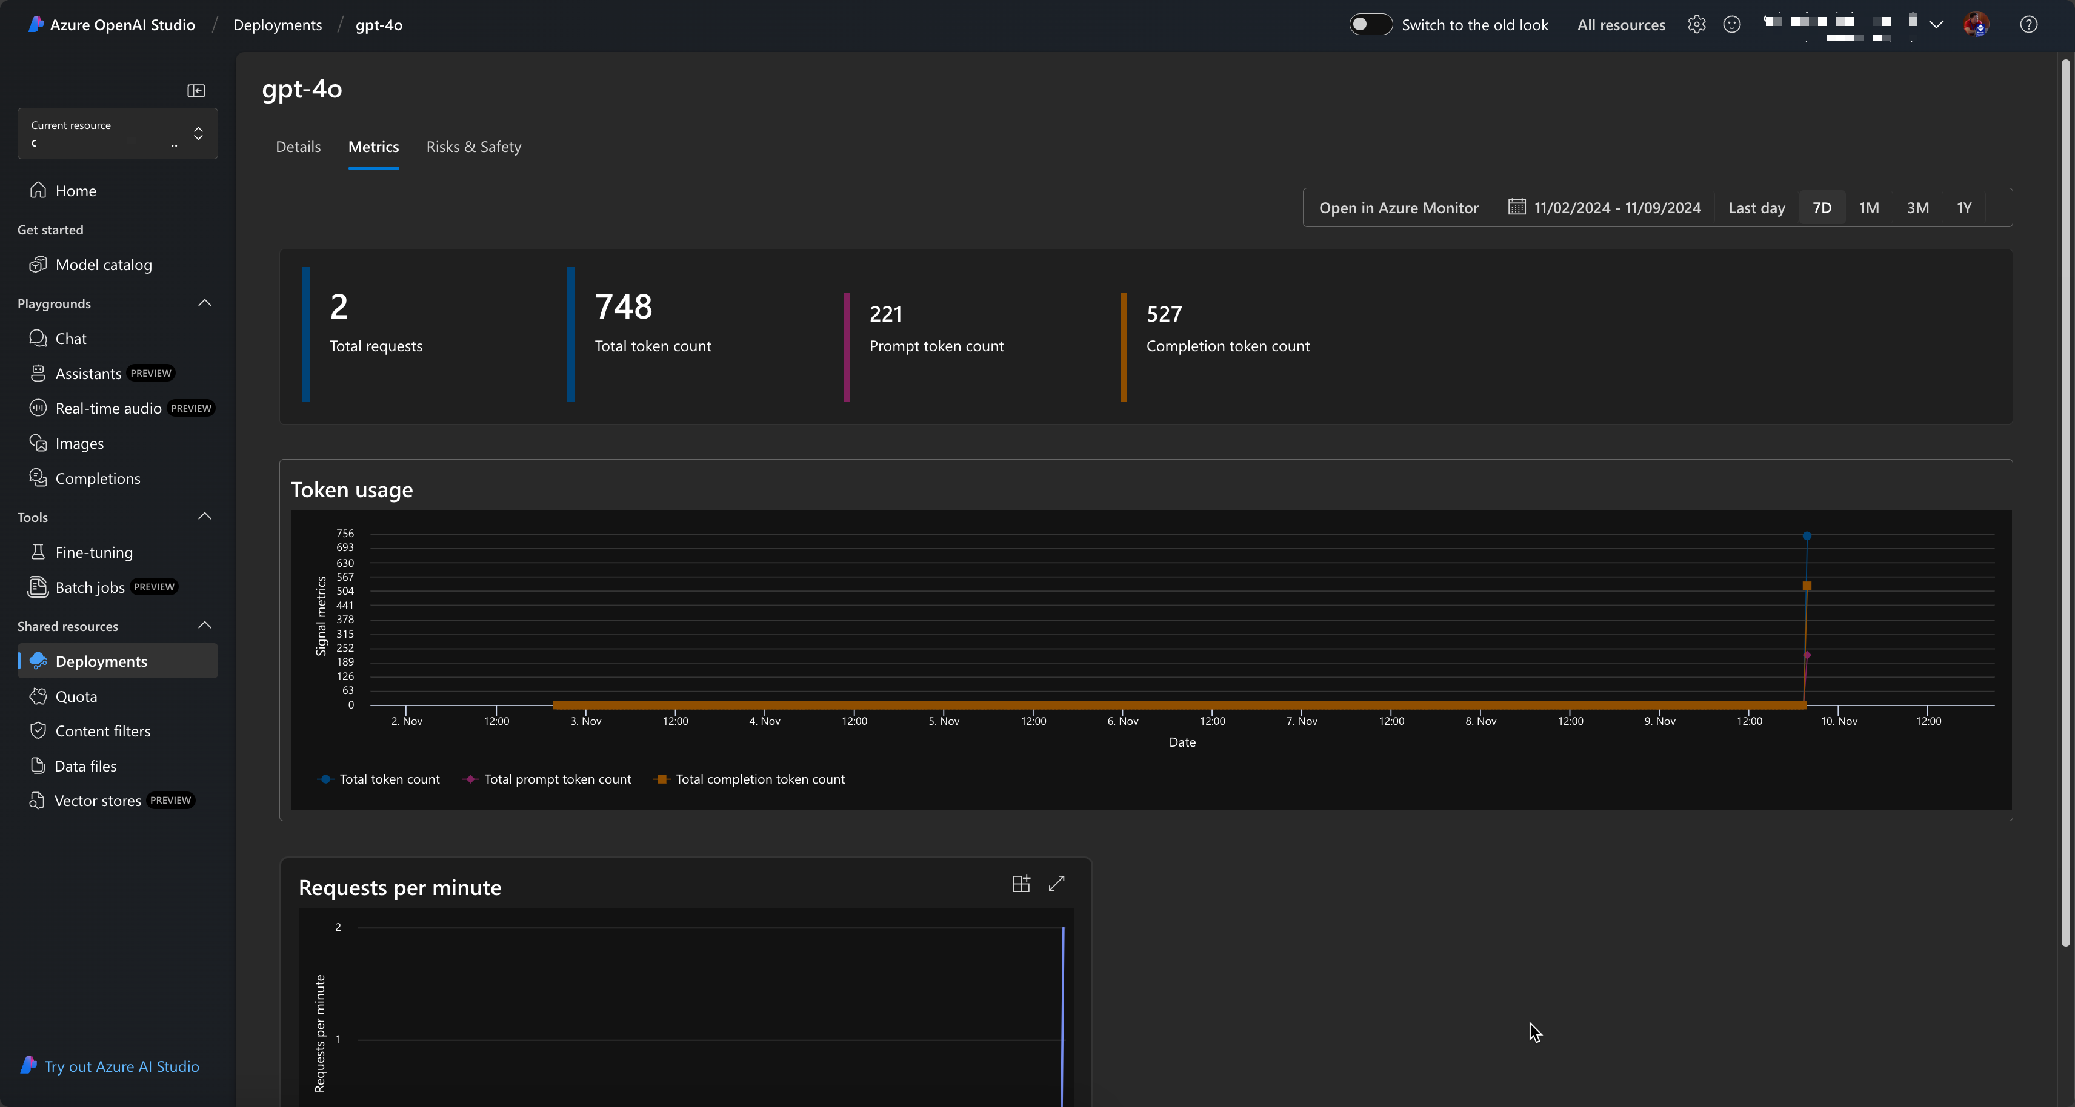
Monitoring Azure OpenAI – OOB Options

Slide 7
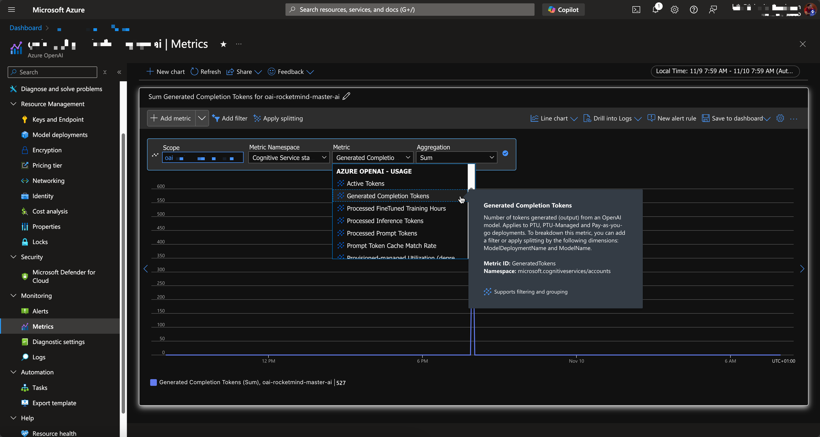
Monitoring Azure OpenAI – OOB Options

Slide 8
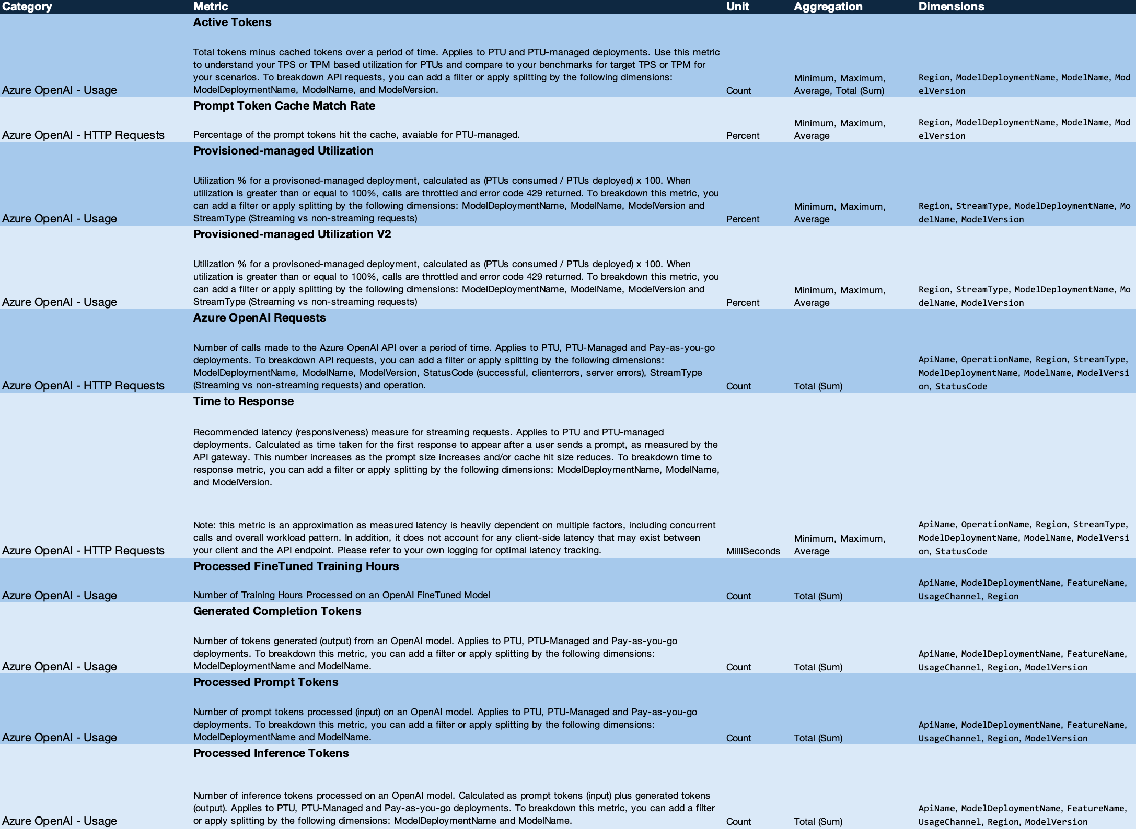
Monitoring Azure OpenAI – OOB Options
https://learn.microsoft.com/en-us/azure/ai-services/openai/monitor-openai-reference

Slide 9
SemanticKernel Telemetry demo
https://learn.microsoft.com/en-us/semantic-kernel/concepts/enterprise-readiness/observability/telemetry-with-app-insights?tabs=Powershell&pivots=programming-language-csharp

